Slide 1


Geomechanical Properties of a Rock Analysis
Lily Kingston

Slide 2
Goals
Understand the relationship between the properties of rock
Use machine learning to model the data

Slide 3
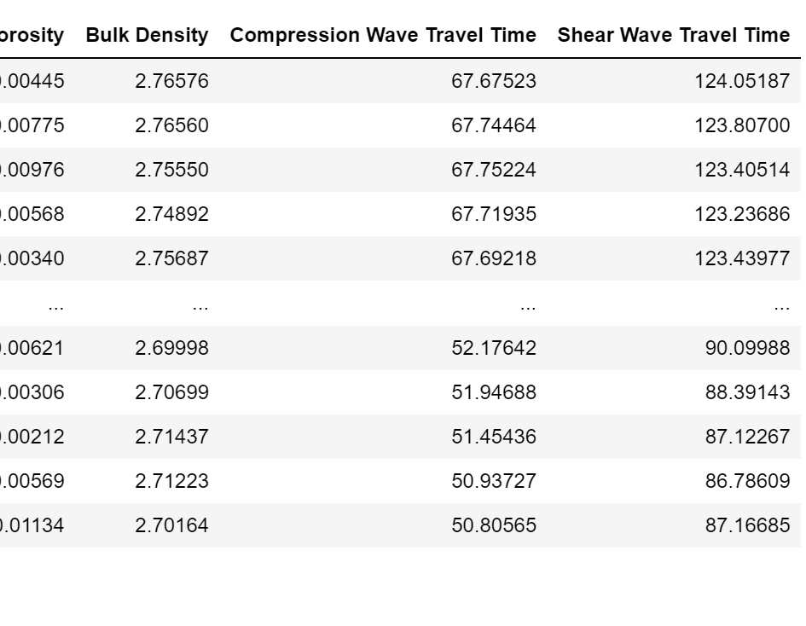
Description of Dataset
The person who created it measured seismic velocity waves of the reservoir rock.
They measured other properties seen in the dataset including:

Slide 4
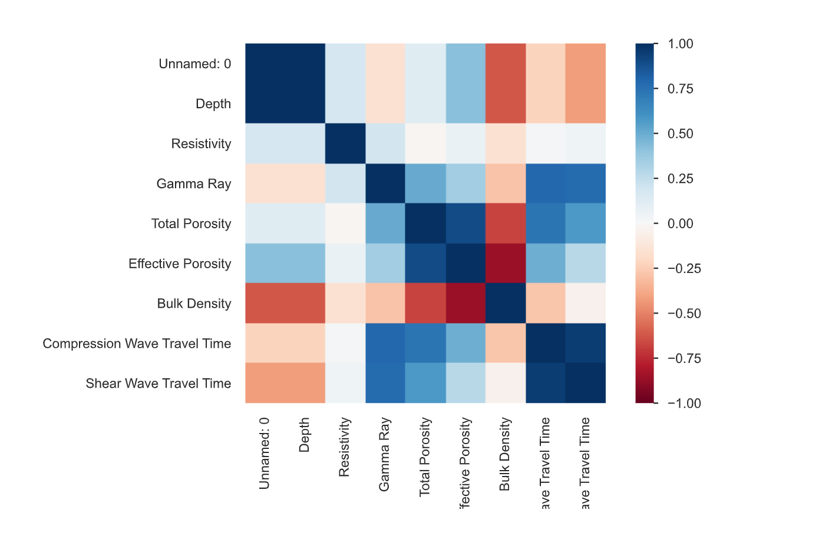
Exploratory Data Analysis
The target is Total Porosity and objective of this analysis to learn which features from the dataset affect total porosity and result in minimizing Total Porosity.
Methods:
Pandas Profiling
Pair Plot

Slide 5
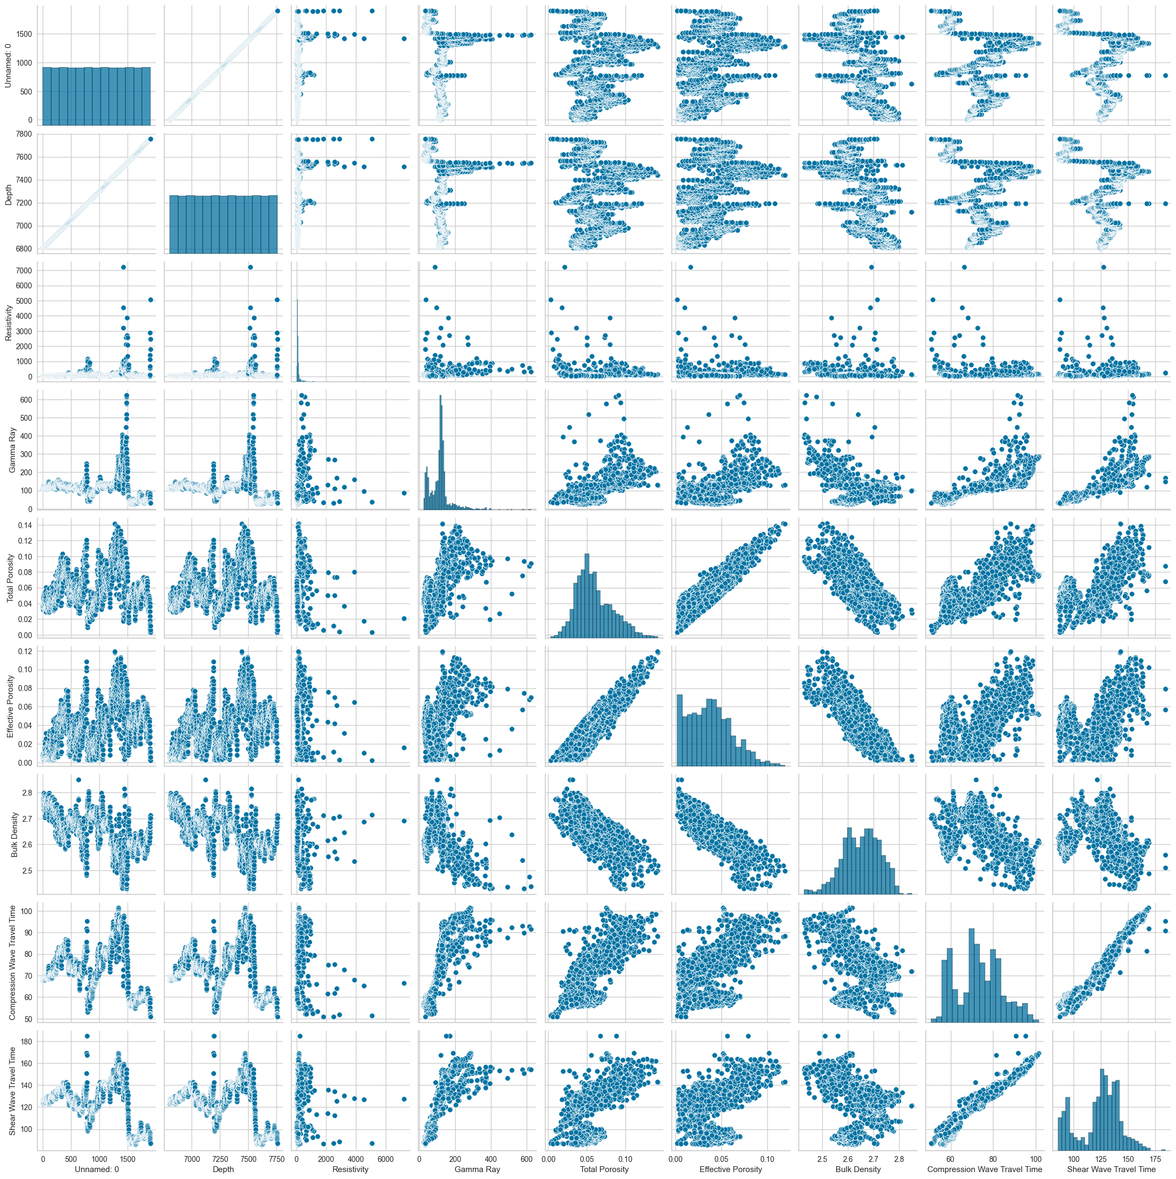
Pair Plot
Mostly linear relationships with Total Porosity

Slide 6
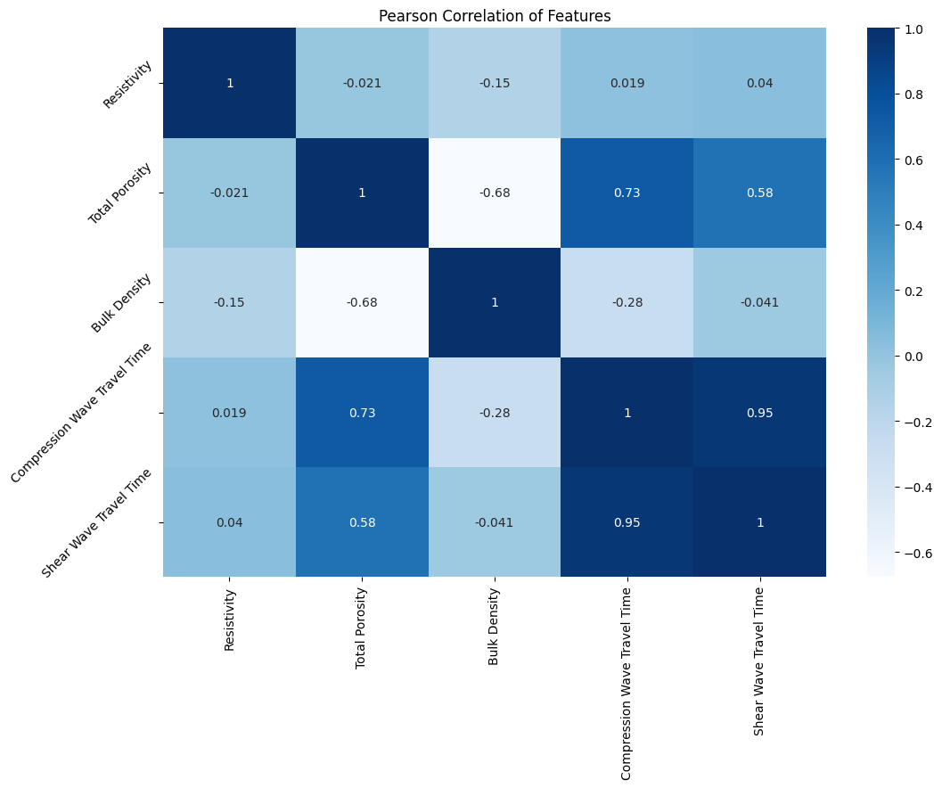
Exploratory Data Analysis
Effective porosity and total porosity were closely correlated, so I decided to eliminate effective porosity.
Compression Wave Travel Time and Shear Wave Travel Time closely correlated, eliminate compression wave.

Slide 7
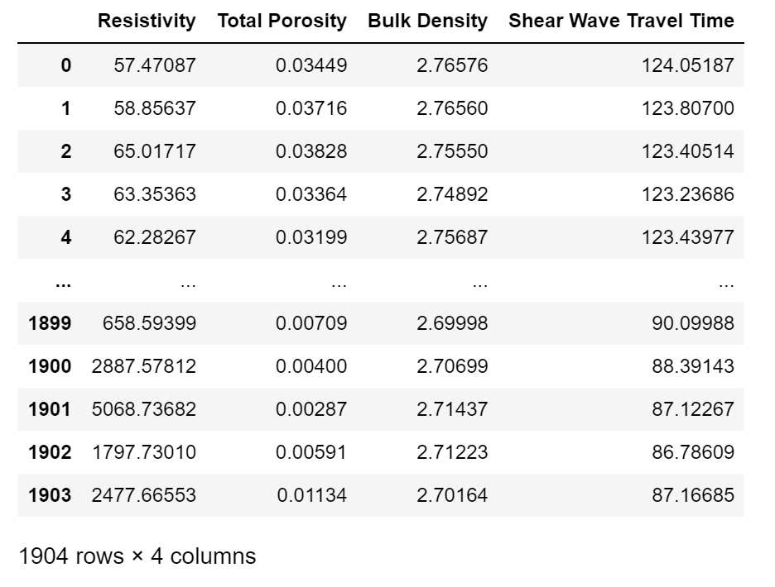
Data Preparation
Drop depth, Unnamed, Gamma Ray as they are irrelevant compared to others.

Slide 8
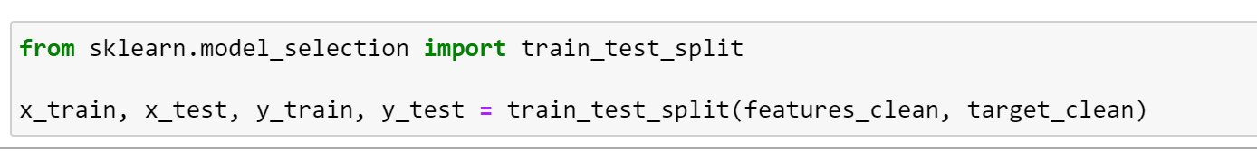
Data Preparation
Create features and target
Features: Resistivity, Bulk Density, Shear Wave Travel Time
Target: Total Porosity
Split the data into test and training sets

Slide 9
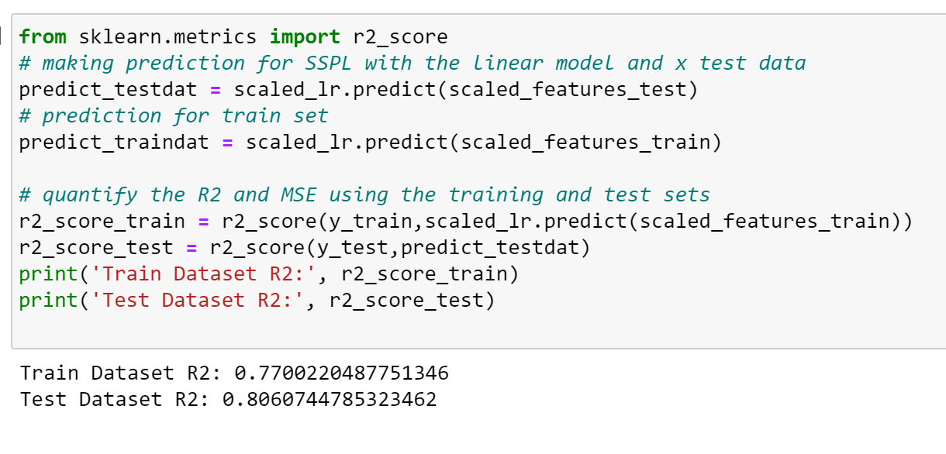
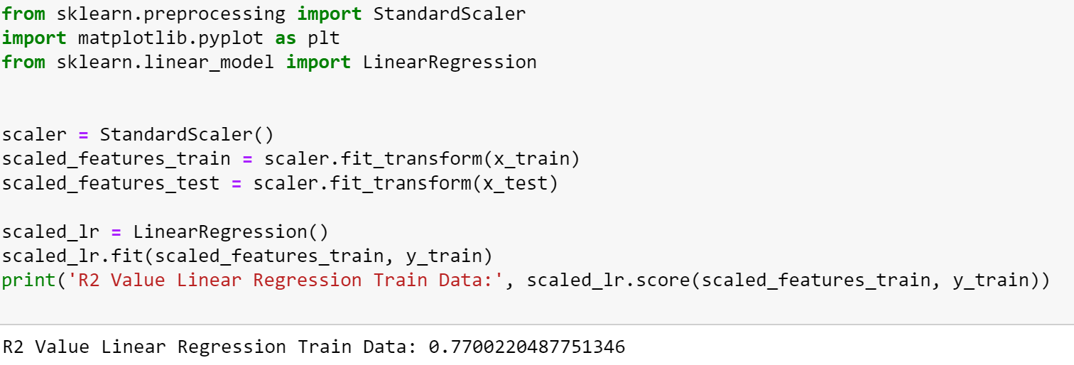
Machine Learning Model
Standardized the features data to make the features have similar magnitude.
Use a linear regression classifier and fit it to the training data
R2 value of 0.77 for training which is somewhat close to 1.0 which indicates an alright fit. 0.86 for the Test data which is a good fit
0.86 greater than 0.77 so it did not overfit.

Slide 10
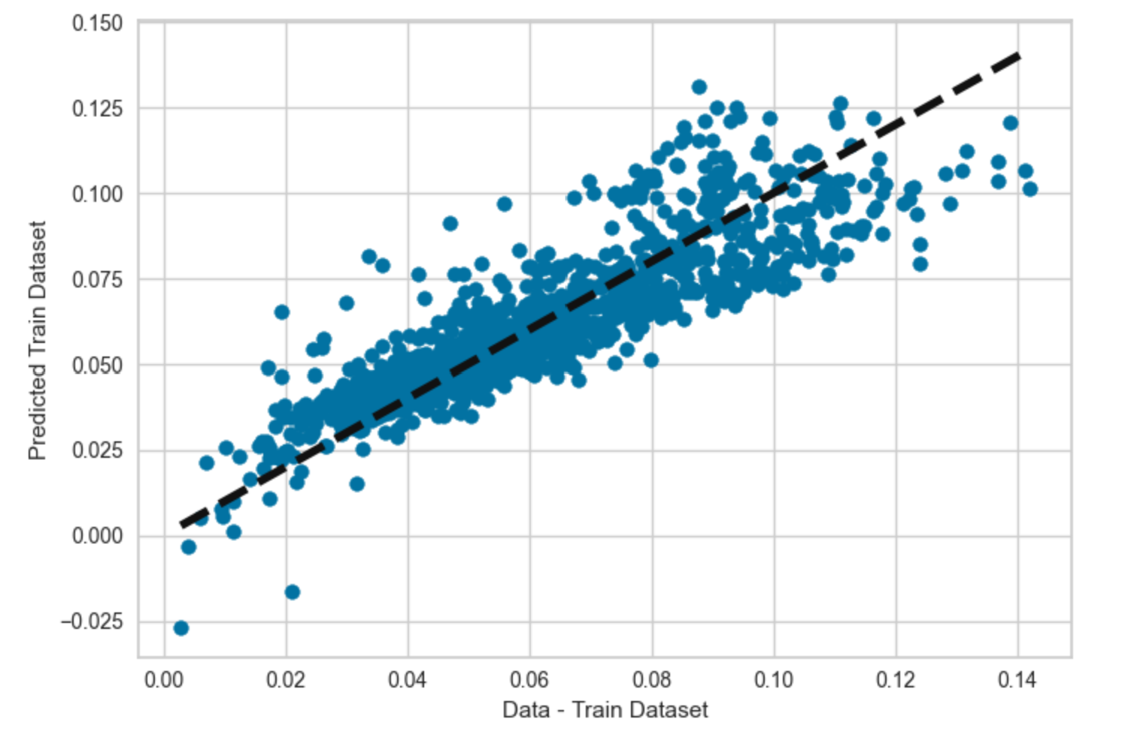
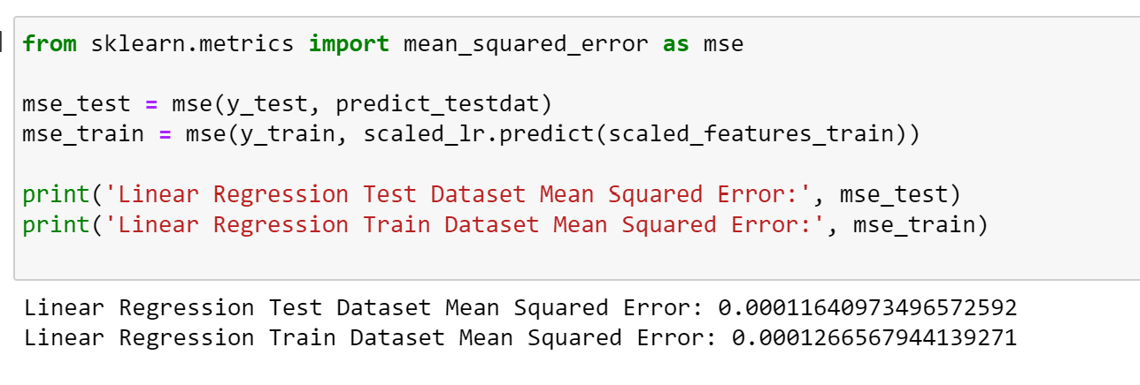
Performance Metrics and Plots
Calculated Mean Squared Error for Linear Regression Model
Plotted the Predicted versus Actual Data which shows the data close to the dotted line indicated it predicted is close to the actual.

Slide 11
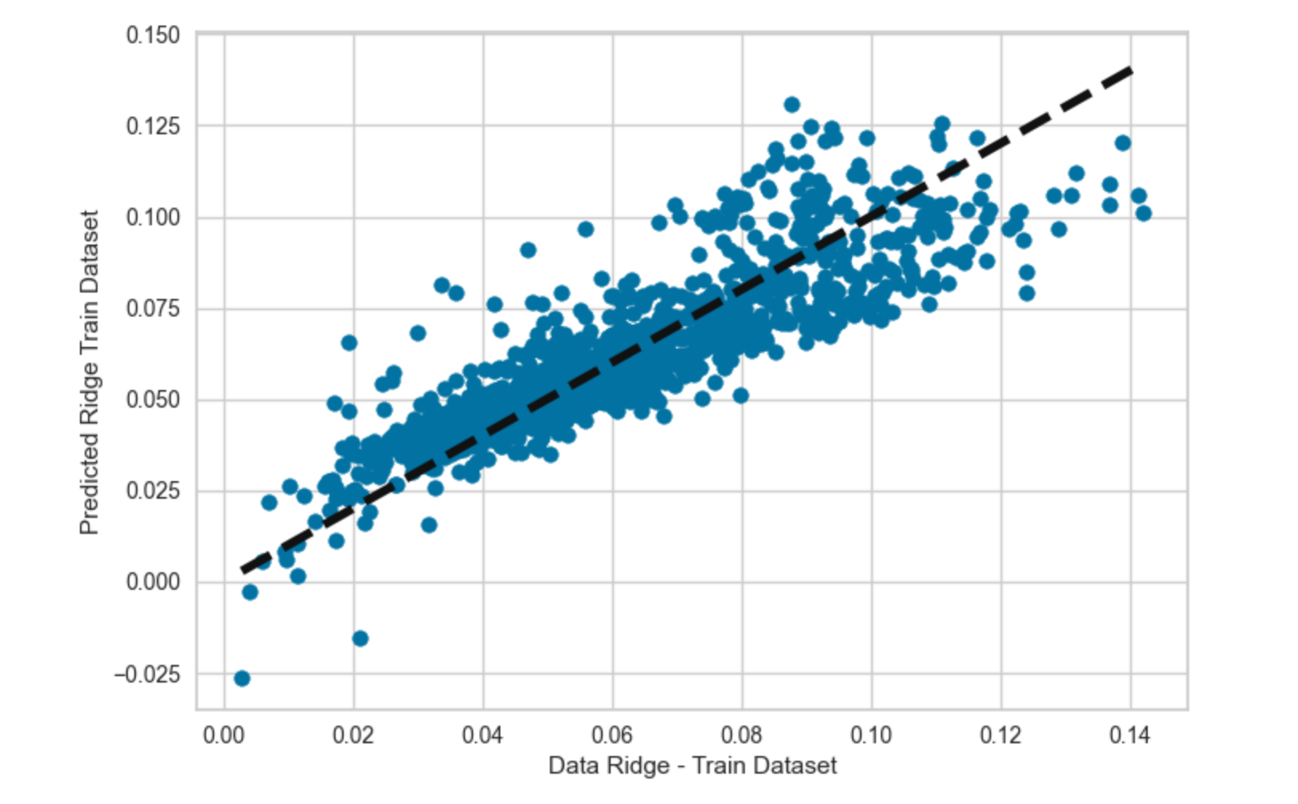
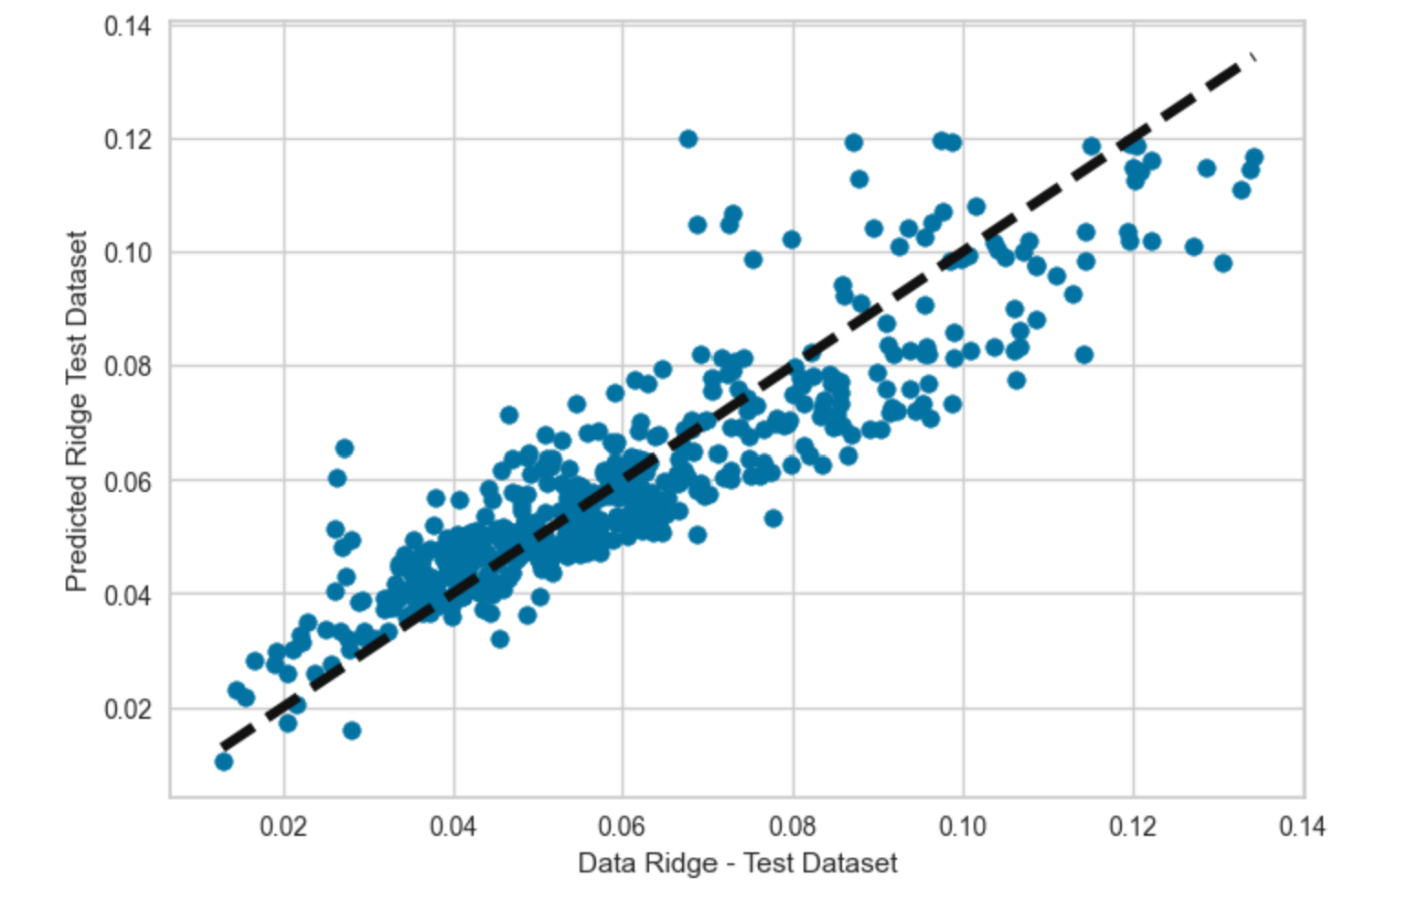
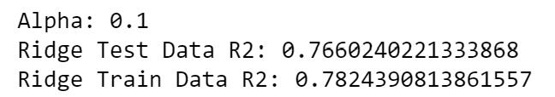
More Models
Tried the Ridge model: It fits the data somewhat well and has an ok R2 value, telling us this model could be just as good as the Linear Regression model.
It did overfit the data slightly, but by a small amount.

Slide 12
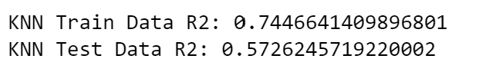
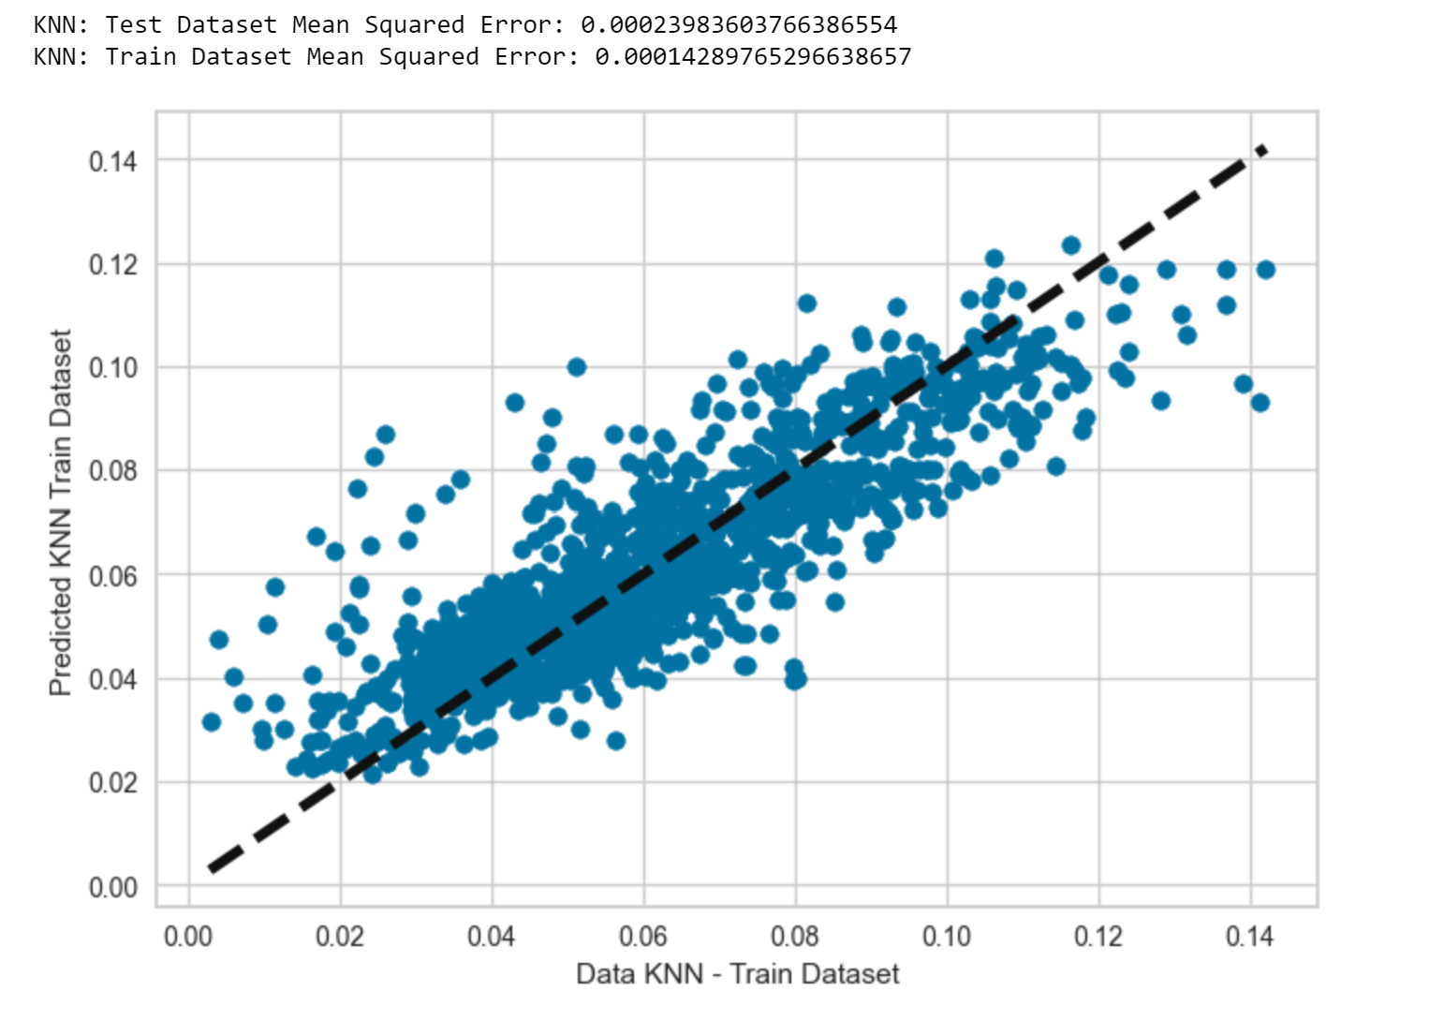
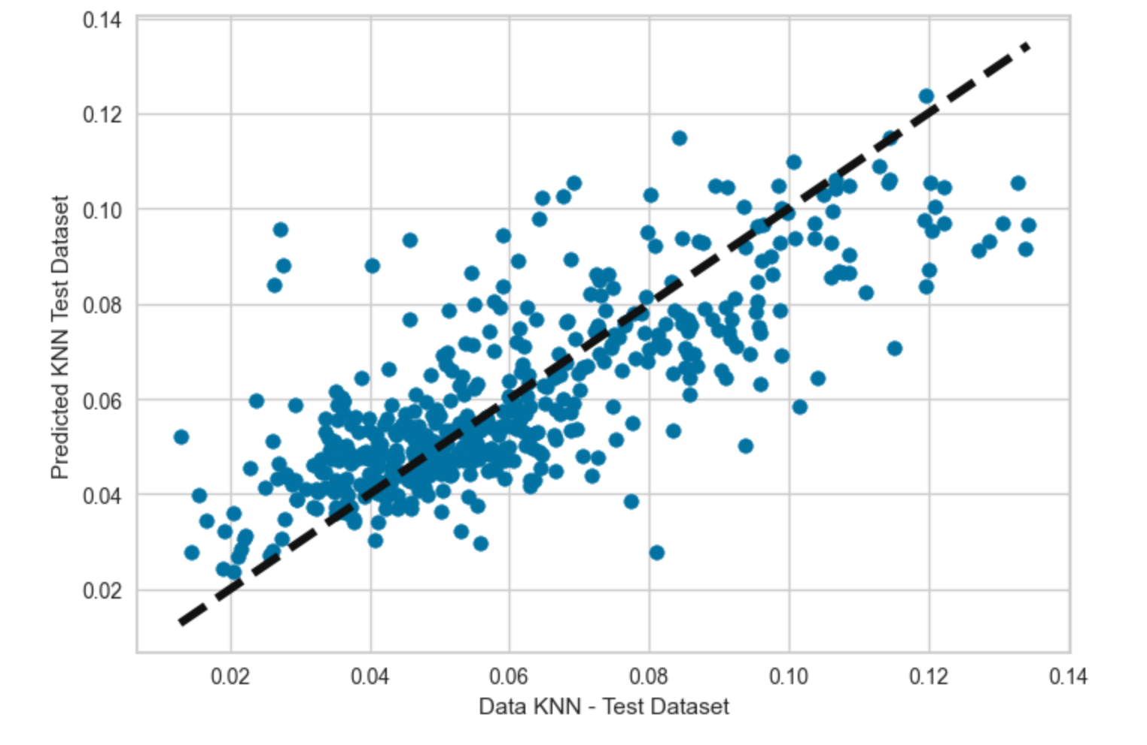
More Models
Tried the K Nearest Neighbor model: It did not have as good of an R2 value for the test data.
The test data R2 is less than training data R2 indicating some overfitting of the data.

Slide 13
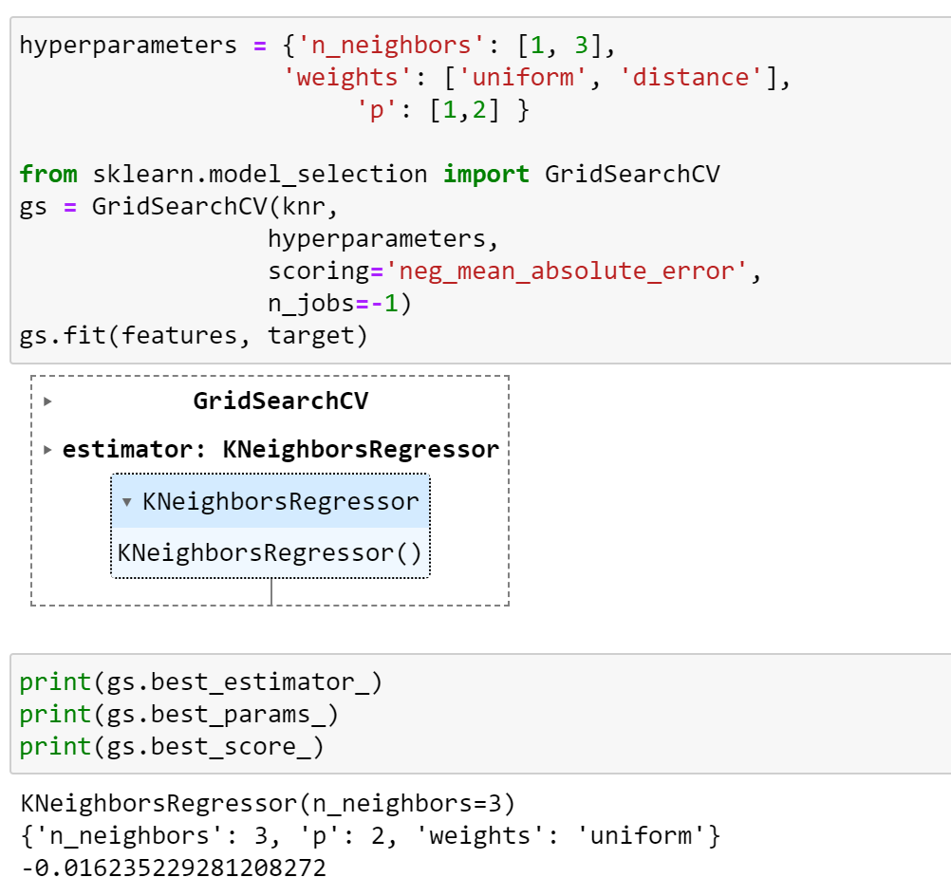
Hyperparameter Tuning for KNN
Tried hyperparameter tuning for the KNN Regression to improve the model.
Grid Search method

Slide 14
Conclusions
Linear Regression Model is the best fit to predict future data for the total porosity of the rock compared to a feature such as bulk density or resistivity.
The Ridge model is the next best model.
Lower bulk density value results in higher total porosity.
Shear wave travel time has a positive linear relationship with total porosity.

